Slide 1
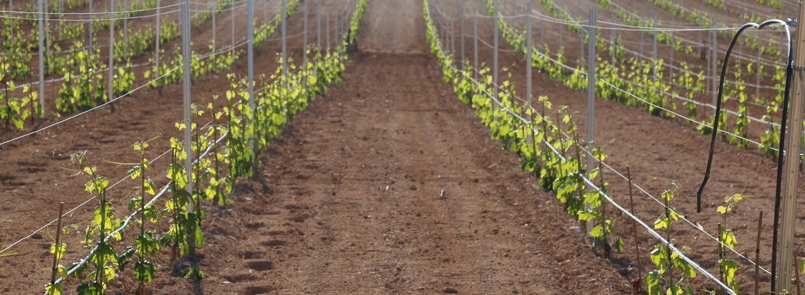
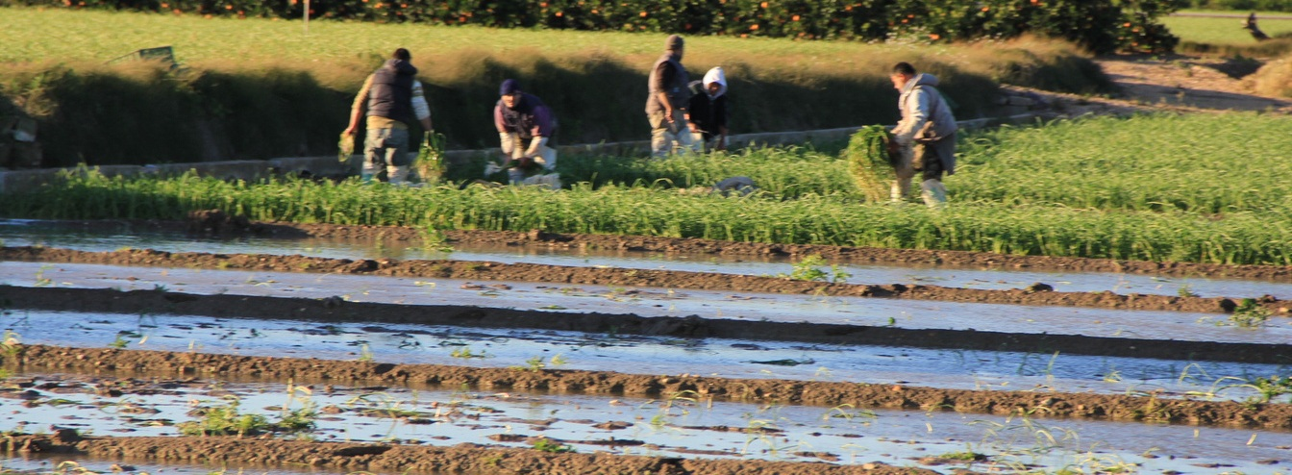

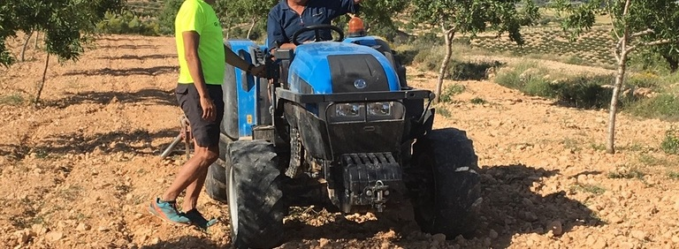
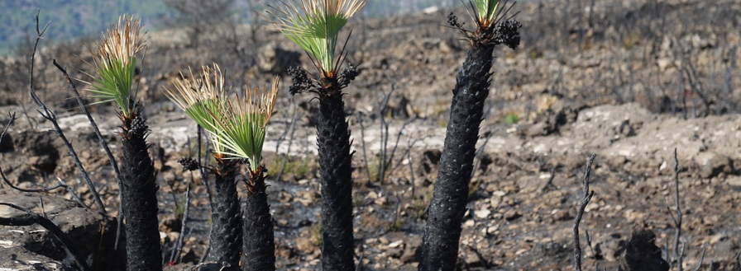
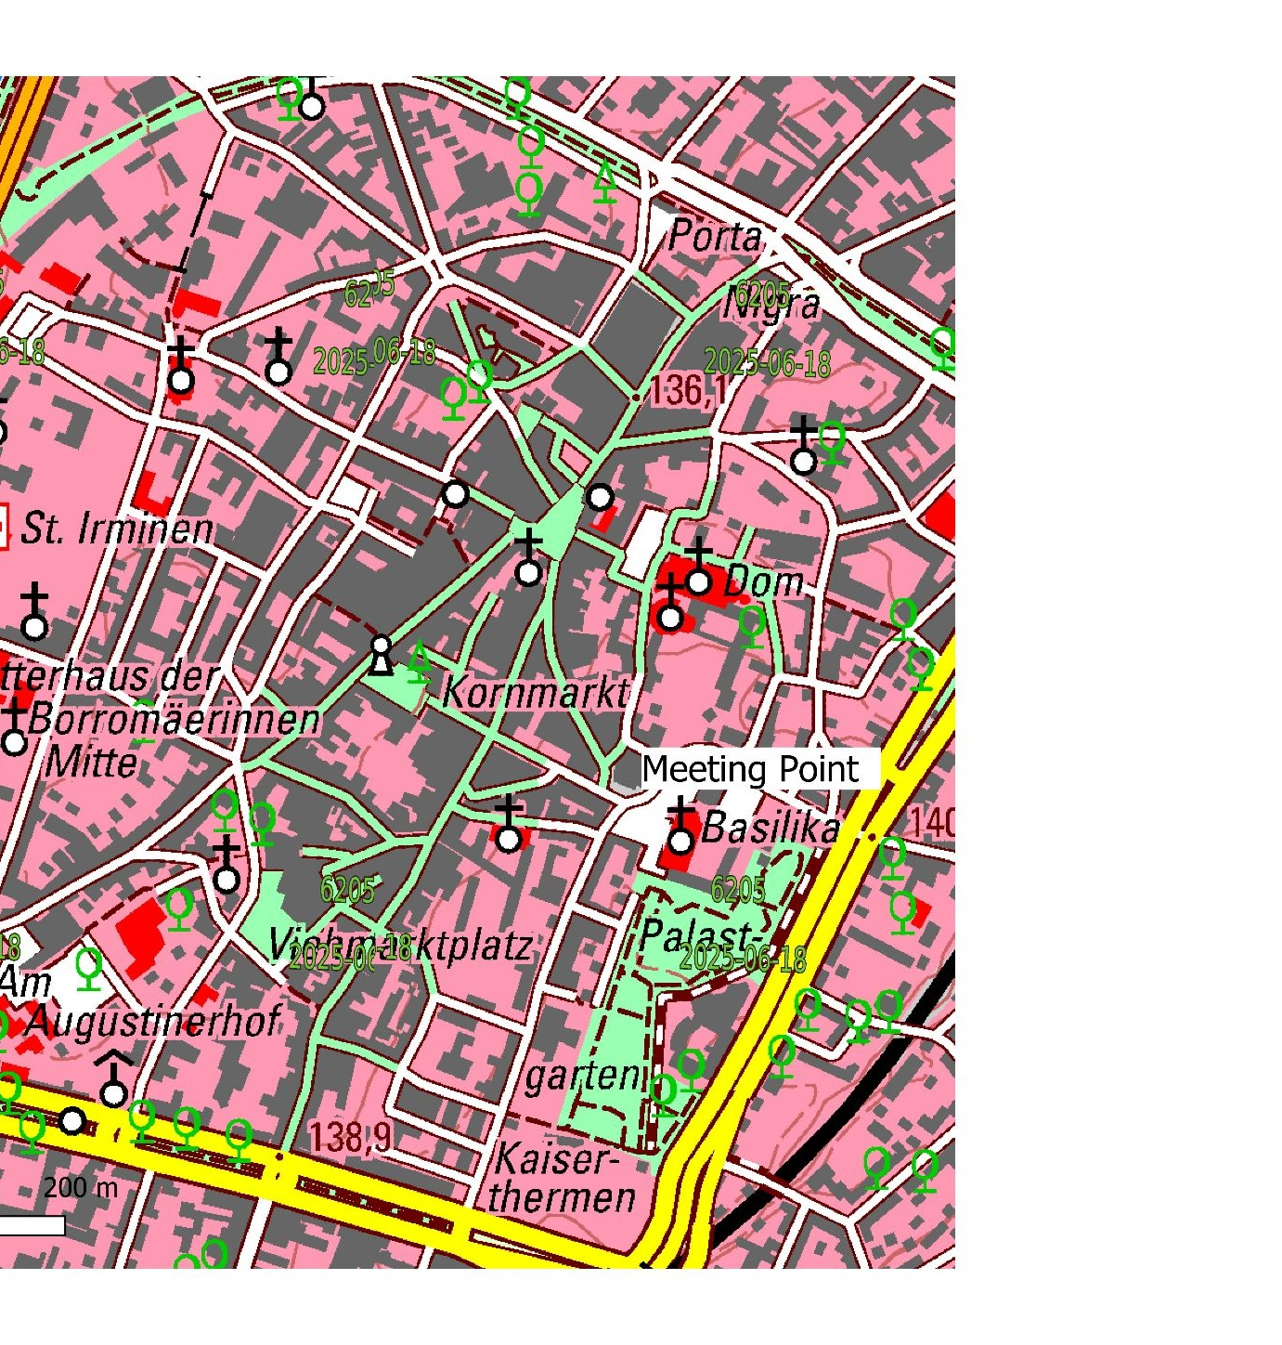
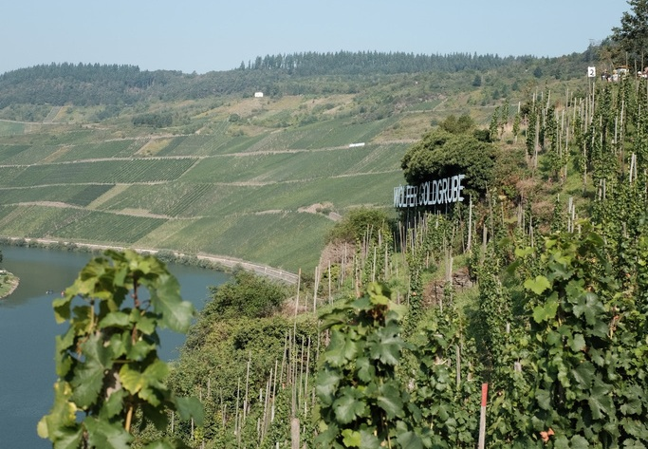
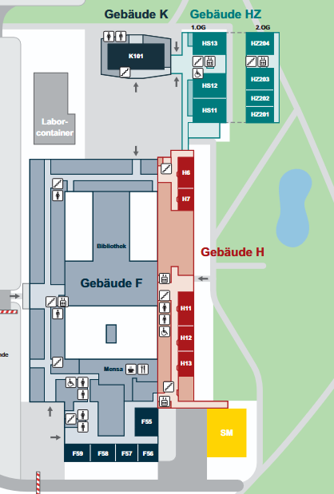




PROGRAMME AT A GLANCE
HS11
TERRAenVISION 2026
Nature-based Solutions to facilitate the transition for living within the Planetary Boundaries
www.terraenvision.eu
6-10 September 2026 | Trier, Germany | University Trier - Campus 2
SUNDAY
6 SEP
MONDAY
7 SEP
TUESDAY
8 SEP
WEDNESDAY
9 SEP
THURSDAY
10 SEP
08:00-09:00
Registration
08:30-09:00 HS11
08:00-09:00
08:00-09:00
Foyer HZ
Opening
Registration
Registration
University Trier & TERRAenVISION
09:00-10:30 HS11
09:00-10:30 HS11
09:00-10:30 HS11
AGRICULTURE & NATURE
URBAN & INDUSTRIAL AREAS
NATURAL HAZARDS Fire, floods & droughts
Gera van Os
John Reid (NZ)
Discussion
Fransje Hooijmeijer
Ivonne Weichhold
Discussion
Bertram de Rooij
Carla Ferreira
Discussion
09:00-16:00
10,30-11,00
10,30-11,00
CONFERENCE EXCURSION
Foyer HZ
10,30-11,00
Coffee break
Coffee break
Coffee break
River restoration with NBS and steep-slope vineyards in the Saar valley.
Visit to Weingut winery and picnic-style lunch.
15:00-17:00
11:00-12:30
11:00-12:30
11:00-12:30
PARALLEL SESSIONS
PARALLEL SESSIONS
PARALLEL SESSIONS
NBS CITY WALK
AN1 Land Degradation & Restoration HS11
MET1 Integrated Methodologies HZ203
UR2 Greening Cities HS11
SO1 More than Green HZ203
UR3 Cross-scale Urban NBS HS11
NH3 Natural Hazard Mitigation HZ203
MEETING POINT - CAMPUS 2 PARKING LOT
Meeting at Basilika Square.
Exploring Nature-based Solutions in a 2000-year-old city.
12,30-14,00
12,30-14,00
12,30-14,00
Foyer HZ
Lunch break
Lunch break
Lunch break
14:00-15:30 HS11
14:00-15:30 HS11
14:00-15:30
METHODOLOGIES
SCIENCE BROKERS
PANEL / WORKSHOP
Bob Klein Lankhorst
Paul van Dijk
Discussion
Birgit Peters
Feras Youssef
Discussion
AN6 Sustainable Terroir HS11
SO4 Circular Land & Soil Management HZ203
Detailed program
15:30-17:00
15:30-17:00
15:30-16:15 HS11
PARALLEL SESSIONS
PARALLEL / WORKSHOP
CLOSING SESSION
AN4 NBS in Agriculture HS11
MET7 Implementation & Monitoring HZ203
UR4 Phytomanagement HS11
SO5 Social Innovation HZ203
MET6: Tracking the ecological value (panel) HZ202
Implementation opportunities & barriers of NBS
Where do we go next? TERRAenVISION 7
17:00-18:30
17:00-18:30
POSTER SESSION
POSTER SESSION
Drinks & snacks - Foyer HZ
Refreshments - Foyer HZ
20:00
CONFERENCE DINNER
Weinwirtschaft Friedrich-Wilhelm
Preliminary programme - subject to minor changes
TOGETHER WE GROW STRONGER

